Slide 1
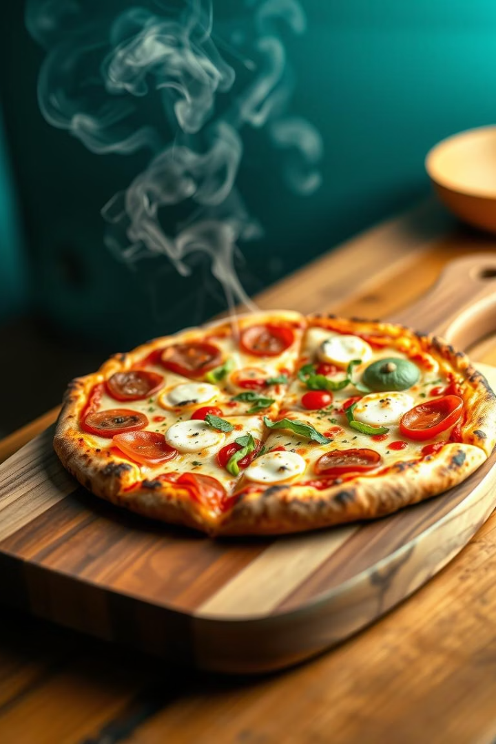
Plato's Pizza: Sales Optimization
This project analyzes Plato's Pizza sales data to identify key trends and optimize marketing strategies. We will explore top-performing products, peak demand hours, and customer preferences. Our goal is to enhance profitability and customer retention.

Slide 2

Project Overview & Dataset
Project Objective
Understand pizza category performance, sizes, and ingredients. Identify sales trends and customer preferences across time, day, and month. Data-driven insights for strategic decisions.

Slide 3
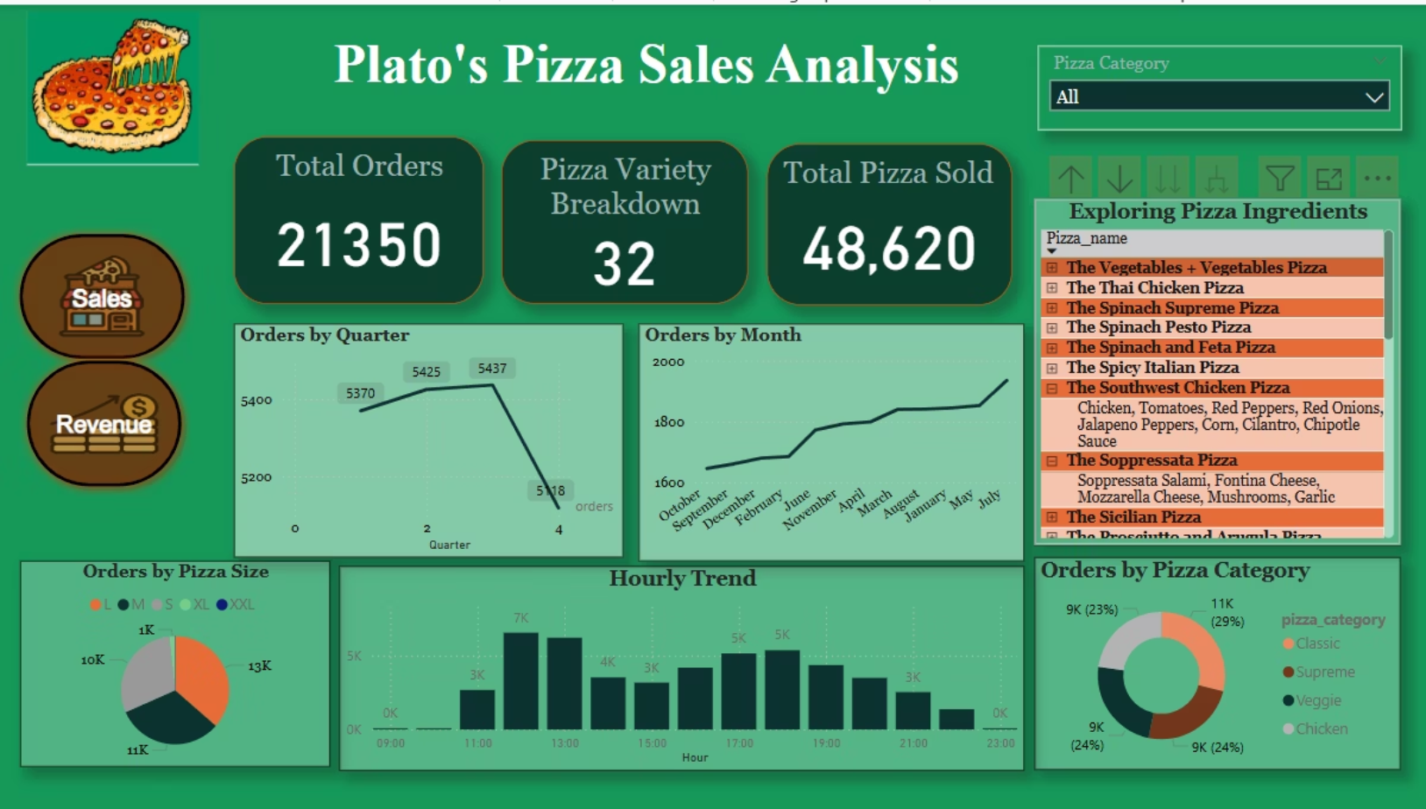

Slide 4
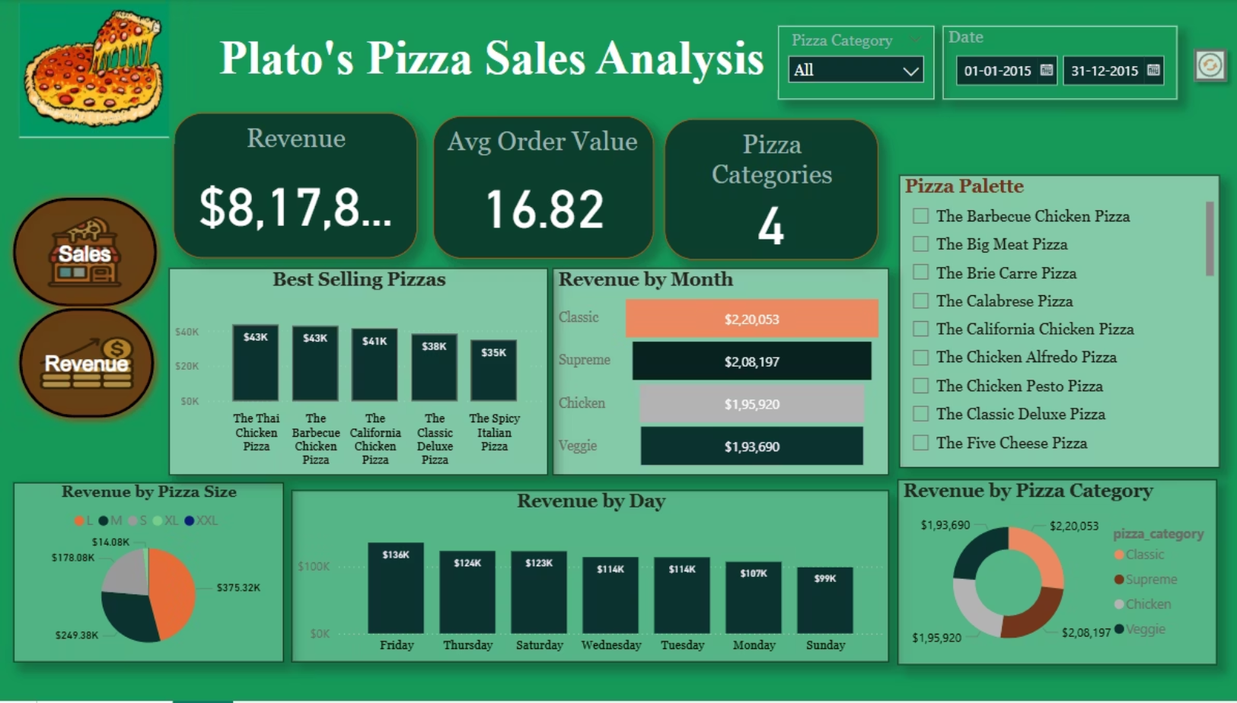

Slide 5

Key Revenue Insights
$817,860
Total Annual Revenue
Strong overall sales performance.
$375K
L-Size Pizza Revenue
Largest contributor to total sales.
$220K
Classic Pizza Revenue
Top-performing pizza category.
$208K
Supreme Pizza Revenue
Another high-performing pizza category.

Slide 6
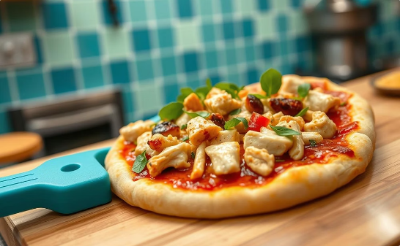
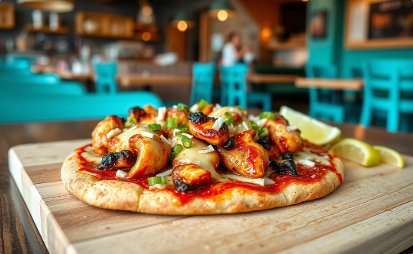
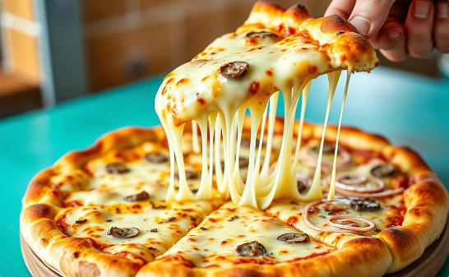
Key Insights
Top-Selling Pizzas
Thai Chicken Pizza
Barbecue Chicken Pizza
Best-Selling Items
Generated $43K in sales.
Also generated $43K in sales.
Both were best-selling items.

Slide 7






Key Insights
Sales Trends: Time and Day
Peak Hours
Sales peaked at 12 PM (lunch) and 6 PM (dinner).
Popular Days
Friday and Thursday drove significant sales.
Order Volume
21,350 total orders were placed.
Pizzas Sold
48,620 pizzas across 32 varieties sold.

Slide 8
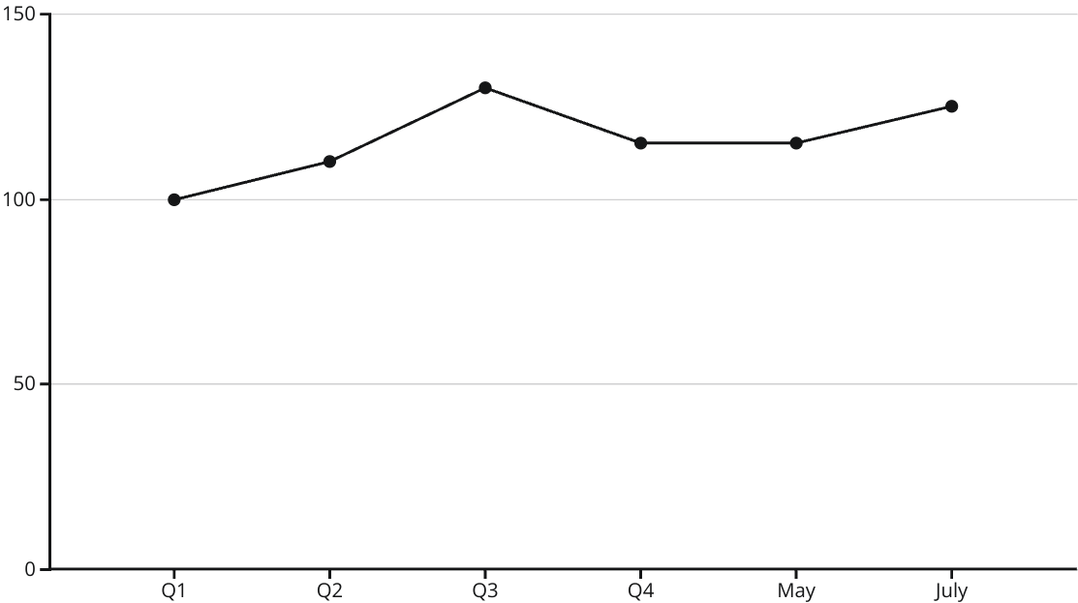
Key Insights
Seasonal & Monthly Patterns
Orders spiked in Q3, followed by a slight dip in Q4. Monthly sales consistently increased leading up to May and July. These patterns inform strategic promotions.

Slide 9


Actionable Recommendations
Promote Top Pizzas
Upsell During Peak
Focus marketing on Thai Chicken, Barbecue Chicken, and L-sized options.
Encourage upselling during lunch (12 PM) and dinner (6 PM) rushes.
Loyalty Programs
Implement loyalty programs or discounts on Thursdays and Fridays.
Create meal bundles featuring top-selling pizzas, which can encourage customers to purchase more, increasing average order size.

Slide 10




Strategic Implementation
Meal Bundles
Summer Offers
Q4 Strategy Refinement
Create bundles with best-selling pizzas. Increase average order size.
Introduce limited-time summer promotions. Attract customers and boost revenue.
Analyze and refine Q4 strategies. Maintain consistent sales during the holiday season.

Slide 11



Conclusion
The dashboard provides valuable insights into customer preferences and sales. Data-driven strategies optimize marketing and sales efforts. Power BI transformed raw data into actionable insights. This enables Plato's Pizza to boost profitability and improve customer satisfaction.
Review Insights
Analyze all key findings.
Implement Strategies
Put recommendations into action.
Monitor Performance
Track results and adjust as needed.

